Slide 1


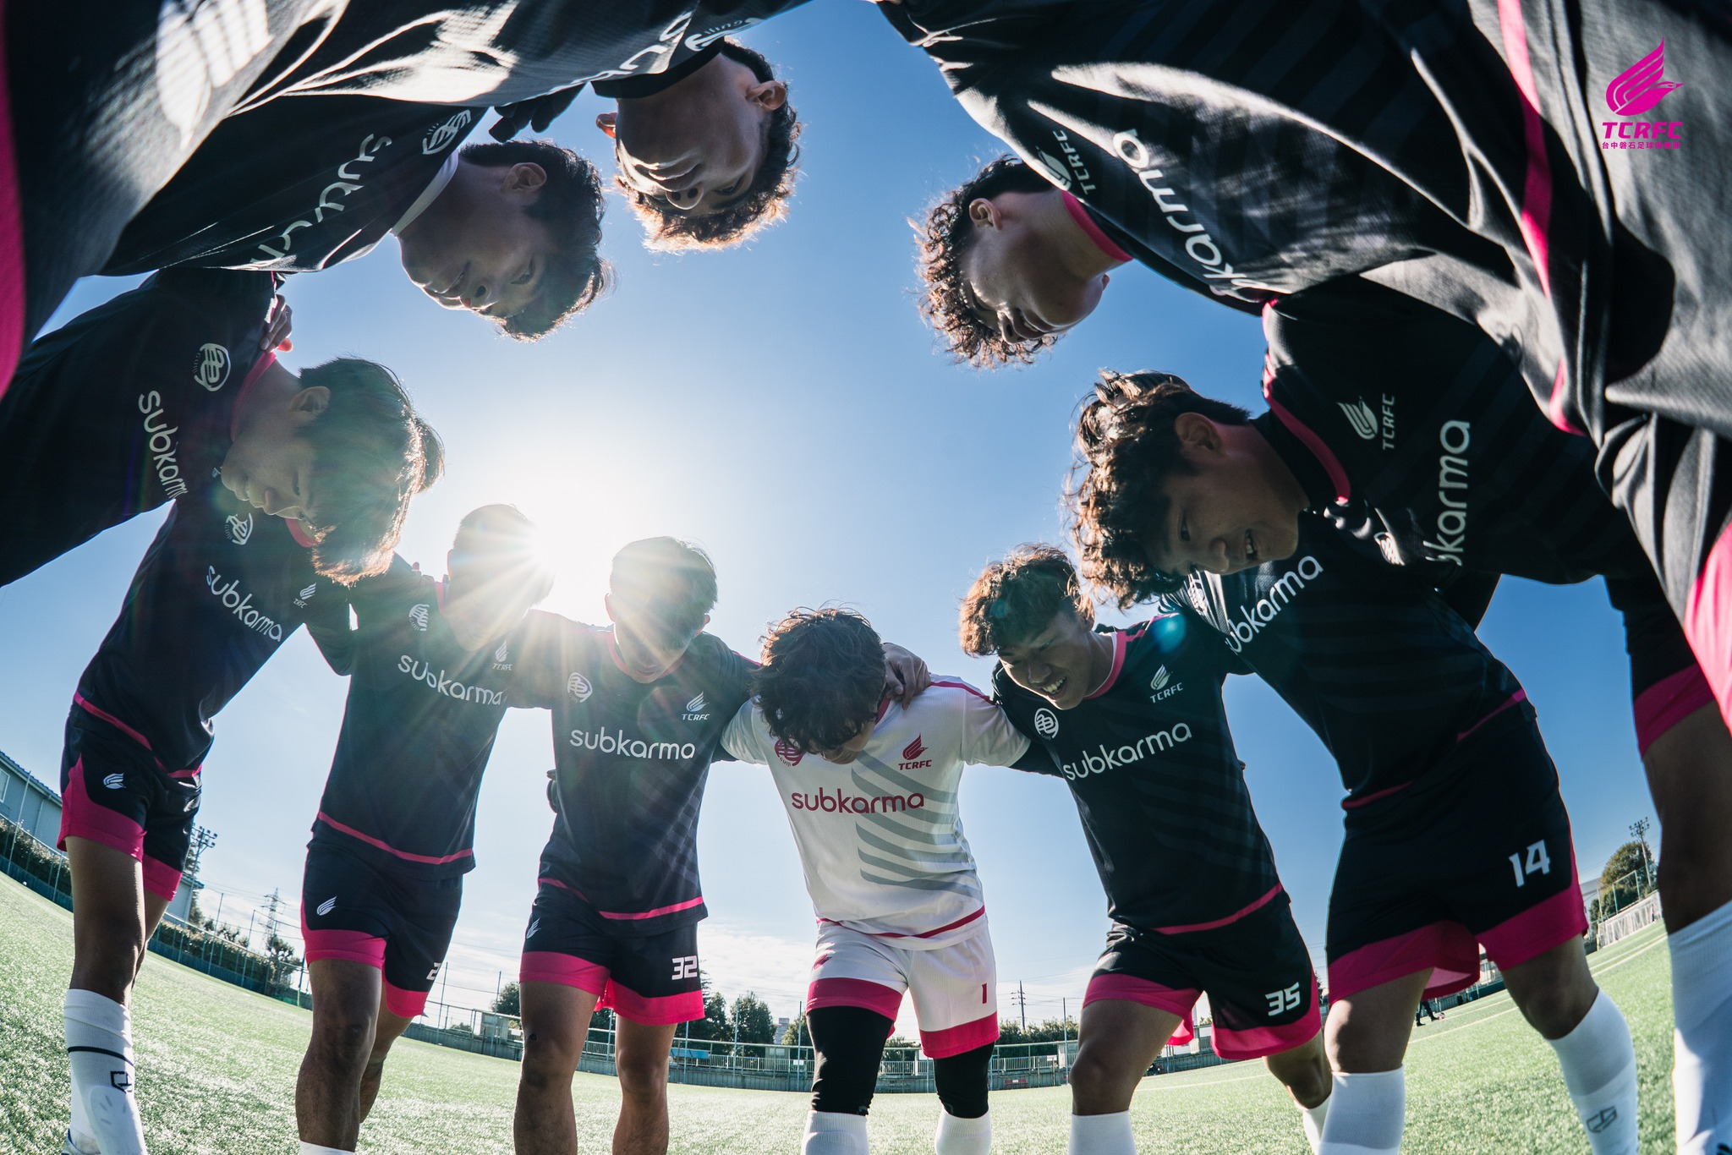
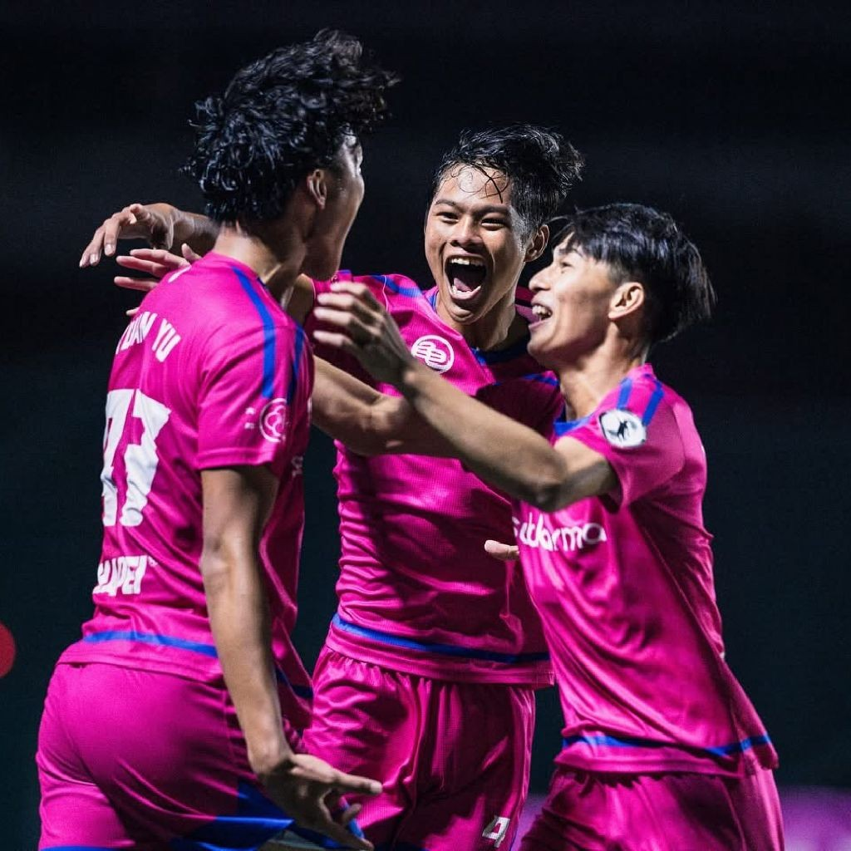
INSPIRING PLAYERS.
SHAPING CHAMPIONS.
啟發球員．塑造冠軍
LOCAL PRIDE. GLOBAL INFLUENCE.
在地驕傲．撼動全球
PRESENTER
TERRY | FOUNDER

Slide 2

WHAT TCRFC IS
不只是一支足球隊
MORE THAN A FOOTBALL CLUB
超越傳統 足球俱樂部
TCRFC is a professionally owned and managed football organization built to develop elite players, strengthen football culture in Taiwan, and create international pathways for talent.
TCRFC 是一個專業經營、完整持有的足球組織，致力於培育菁英球員、深化台灣足球文化，並為人才打造國際發展道路。
02

Slide 3

WHY WE EXIST
在地扎根．放眼世界
LOCAL ROOTS.
GLOBAL VISION.
在地深耕
全球視野
MISSION:
使命：
Deliver world-class development and global opportunity without losing local identity.
提供世界級培訓與國際機會，同時保有在地認同。
VISION:
願景：
A credible Taiwanese pathway from grassroots to global football.
自基層到全球賽場，建立可信賴的台灣之路。
03

Slide 4



GOVERNANCE & PHILOSOPHY
04
治理與理念
PROFESSIONALLY OWNED. PROFESSIONALLY MANAGED.
完整持有．專業經營
TCRFC is built on long-term planning, structured governance, and professional football standards — not short-term results.
NON-NEGOTIABLES
不可妥協的核心價值
Player-first decisions, strict discipline, and long-term credibility guide every action we take.
PROOF: ELITE TECHNICAL LEADERSHIP
證據：菁英技術領導與長期規劃
We invest in world-class expertise to build our system. Appointed AFC Pro License coach Hiu-Ming Chan as Technical Consultant to drive our long-term development blueprint.
TCRFC

Slide 5



COMPETITIVE FOOTPRINT
競技版圖與里程碑
2024
2025
2026
DIVISION 2
CHAMPIONS
PROMOTED TO
DIVISION ONE
TAIWAN PREMIER
LEAGUE
乙級聯賽冠軍
晉級甲級
企業甲級聯賽出戰
PERFORMANCE THAT
PROVES THE SYSTEM
Consistent progression across age groups and first team.
用成績證明系統
一線隊與年齡梯隊穩定進步。
05

Slide 6


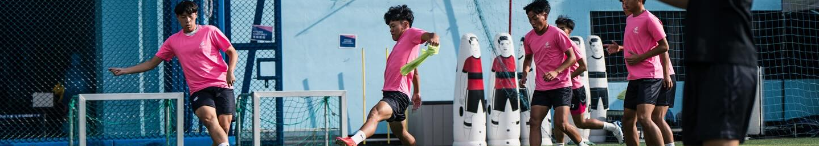
WHAT MAKES TCRFC DIFFERENT
06
我們的差異化
A PLAYER-CENTERED SYSTEM
THE BALANCE
以球員為核心的系統
平衡：紀律與創造力
At TCRFC, development comes before exposure. Structure comes before scale.
We seek the perfect balance: Discipline × Creativity; Data × Humanity.
培育優先於曝光，結構優先於規模，每一項決策皆以球員的長期成長為核心。
我們尋求完美的平衡：紀律×創造力；數據×人性化。
TCRFC

Slide 7







PLAYER DEVELOPMENT MODEL
球員培育模型
TECHNICAL & TACTICAL
PROFESSIONAL FITNESS
技術與戰術
專業體能
Mastery of ball control, passing accuracy, and deep understanding of tactical formations.
Data-driven conditioning, speed work, strength training, and injury prevention protocols.
MATCH INTELLIGENCE
MENTAL RESILIENCE
比賽判讀
心理韌性
Decision making under pressure, spatial awareness, and reading the game flow.
Discipline, leadership, emotional control, and developing a growth mindset.
SUPPORTED BY:
Video Analysis 影片分析
Positional Profiles 位置輪廓
IDPs 個人發展計畫
07

Slide 8
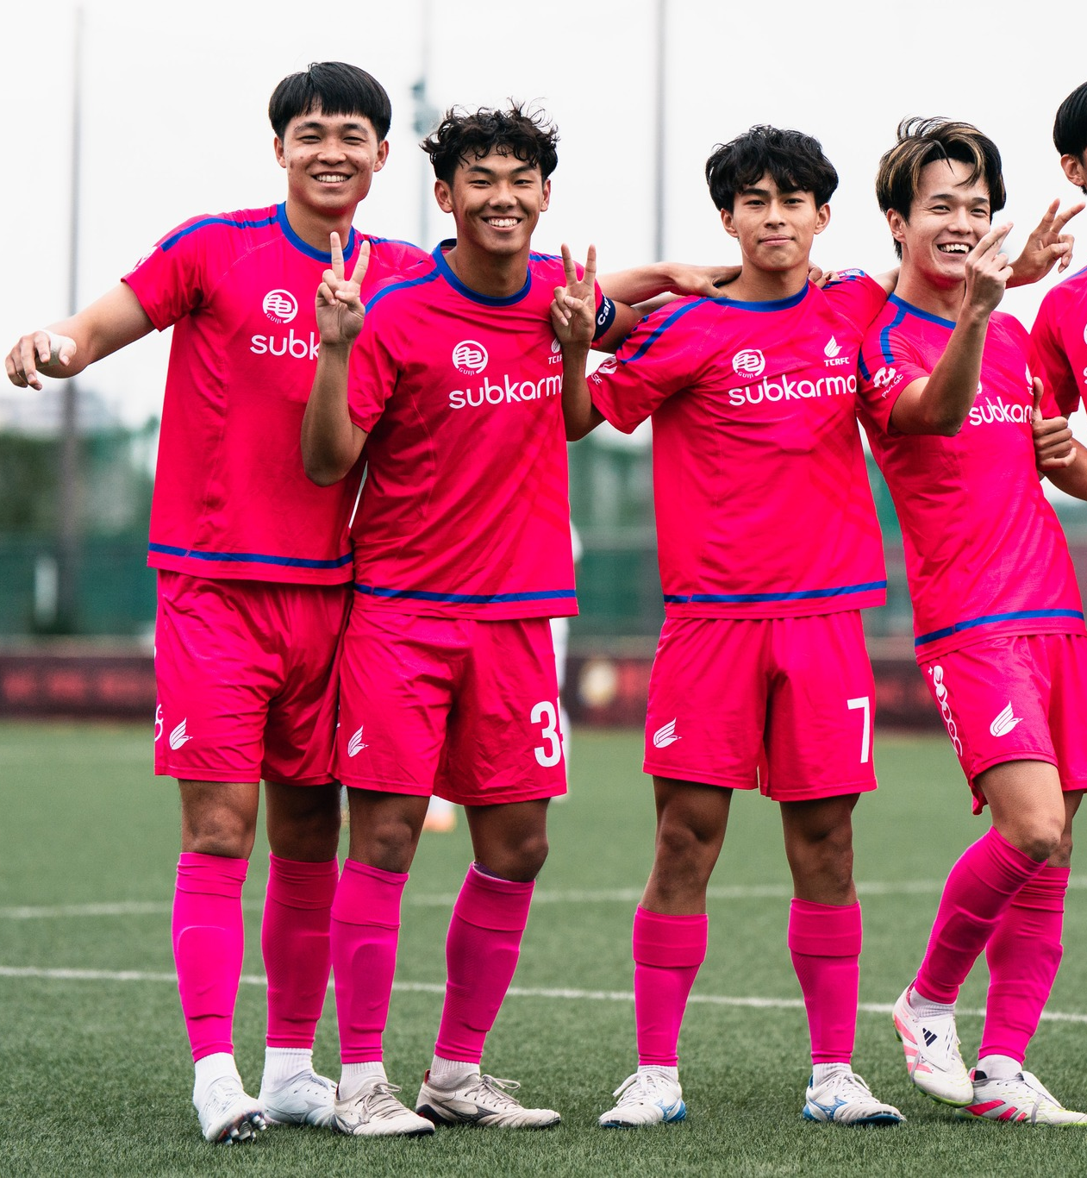





BEYOND FOOTBALL
超越足球：培養完整的人
Developing Complete Individuals. We support players beyond the pitch through language learning, nutrition guidance, lifestyle discipline, and international readiness.
Language Learning
Nutrition Guidance
語言學習
營養管理
Lifestyle Discipline
International Readiness
生活紀律
國際適應力
OUTCOME
Players who lead on and off the pitch.
成果：場上場下皆能領導。
08

Slide 9






DEVELOPMENT PATHWAY
成長路徑
A clear, structured journey from local beginnings to global opportunities.
清晰且可持續的成長路徑：從在地啟蒙到國際舞台。
GRASSROOTS
YOUTH
FIRST TEAM
INTERNATIONAL
基層培訓
青訓系統
一線隊
國際發展
Community programs & school partnerships
U-Teams & elite development squads
Premier League competition & professional mindset
Exchanges, trials & professional contracts abroad
社區計畫與校園合作
年齡梯隊與菁英培訓
海外交流、試訓與職業合約
企業甲級聯賽競爭與職業心態
GATEWAYS: Exchanges, trials, scouting showcases.
通道：交流、試訓、球探觀察。
09

Slide 10
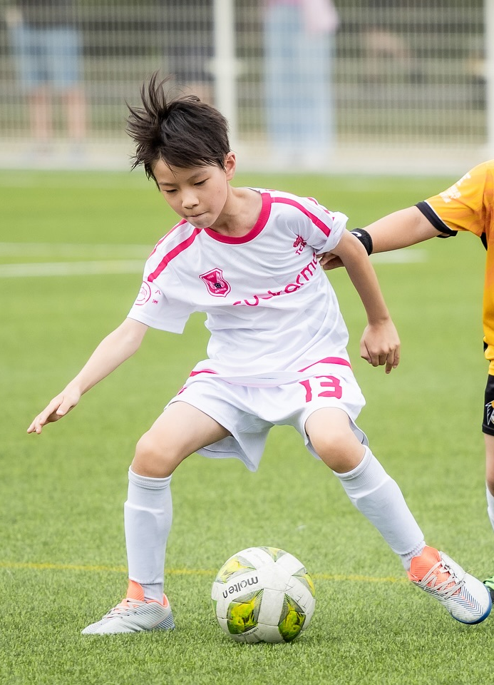



GRASSROOTS & YOUTH
基層與青訓
Growing Football from the Ground Up
從基層扎根足球
TCRFC works closely with elementary schools, junior & senior high schools, and universities to nurture talent early and responsibly.
TCRFC 與國小、國中、高中及大專院校合作，從早期階段有系統地培育足球人才。
Community Sessions
社區訓練
U-Team Selections
菁英選拔
Coach Education
教練培訓
10

Slide 11



CAMPS & PROGRAMS
訓練營與專案
Seasonal summer and winter camps provide focused training environments that emphasize discipline, teamwork, and performance mindset.
寒暑期訓練營提供高品質、具紀律性的培訓環境，強化團隊精神與競技心態。
POSITION CLINICS
HIGH-PERFORMANCE
SCHOOL BREAK CAMPS
專位診斷
高強度週
學期空檔營
Focused technical drills for goalkeepers, defenders, midfielders, and strikers.
Intensive conditioning and tactical immersion for elite preparation.
Structured training during holidays to maintain fitness and sharpness.
為菁英備戰設計的高強度體能與戰術沉浸課程。
針對守門員、後衛、中場與前鋒的專項技術訓練。
利用假期維持體能與球感的系統化訓練。
11

Slide 12
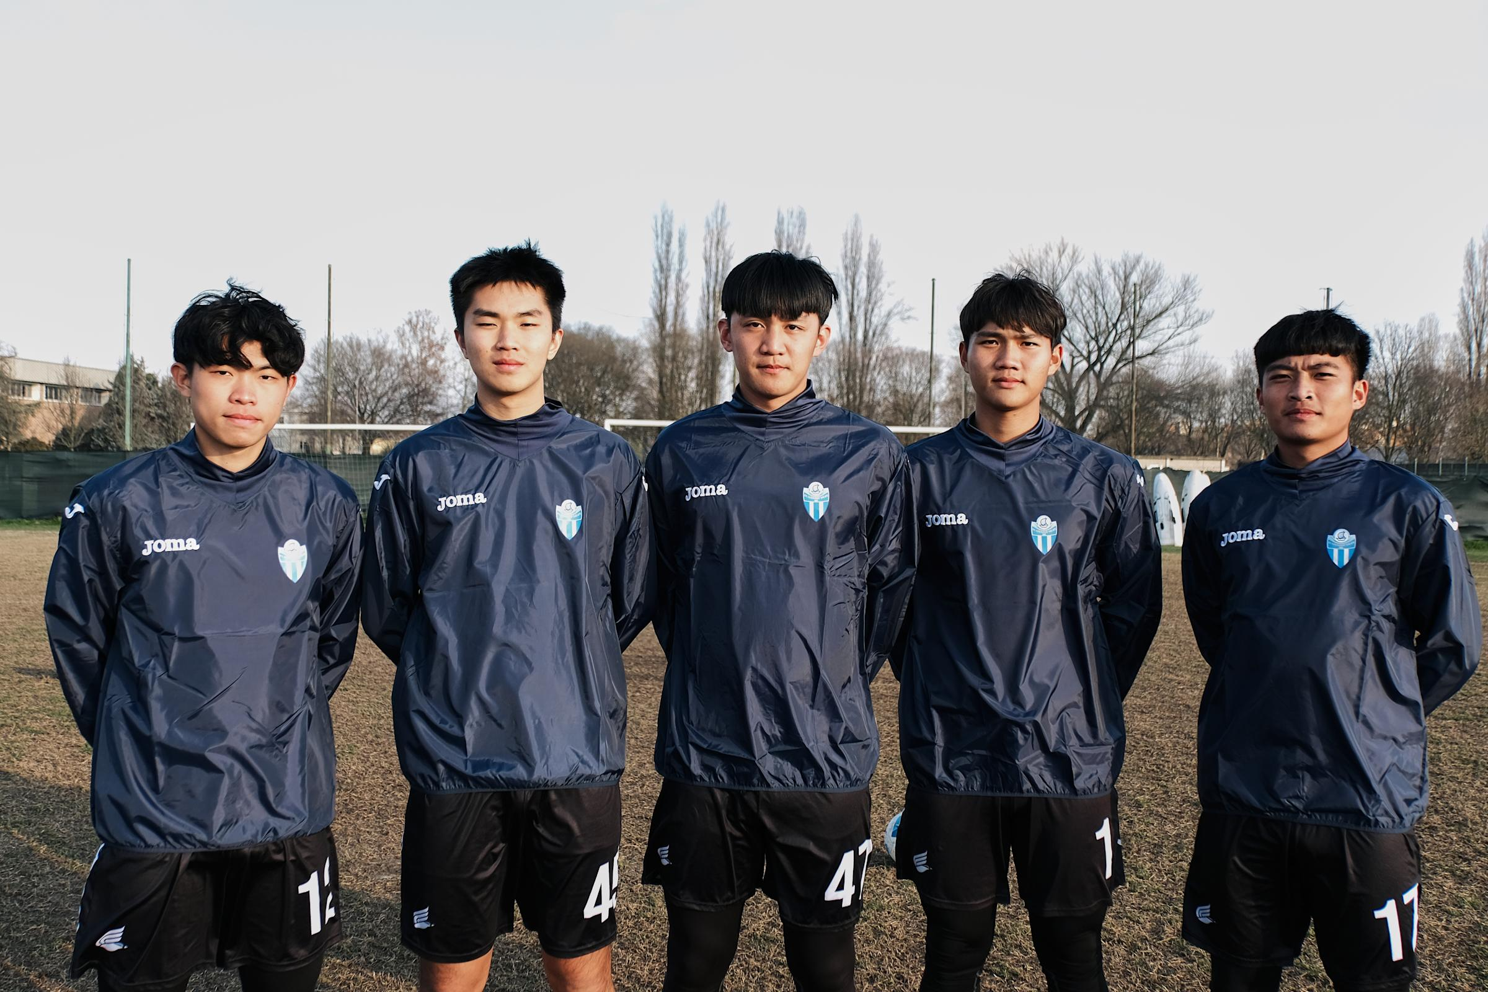

INTERNATIONAL EXPOSURE
國際舞台接軌
REAL GLOBAL
PATHWAYS
真正的
國際舞台
TCRFC provides players with international matches, exchanges, and scouting exposure in regions including Japan, Hong Kong, Germany, and Italy.
TCRFC 安排球員參與日本、香港、義大利等地的國際比賽、交流與球探接軌。
PROOF: ITALY TRAINING
實證：義大利移地訓練
Five players invited to train with Legnago Salus (Italy) and ongoing relationships with clubs like Hellas Verona.
五位球員受邀赴義大利 Legnago Salus 訓練；持續拓展歐洲連結（如 Hellas Verona）。此為台灣球員罕見之高強度歐洲培訓機會。
12

Slide 13
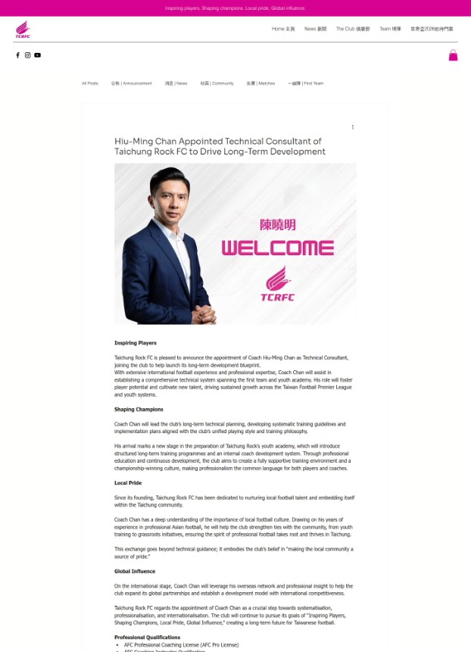
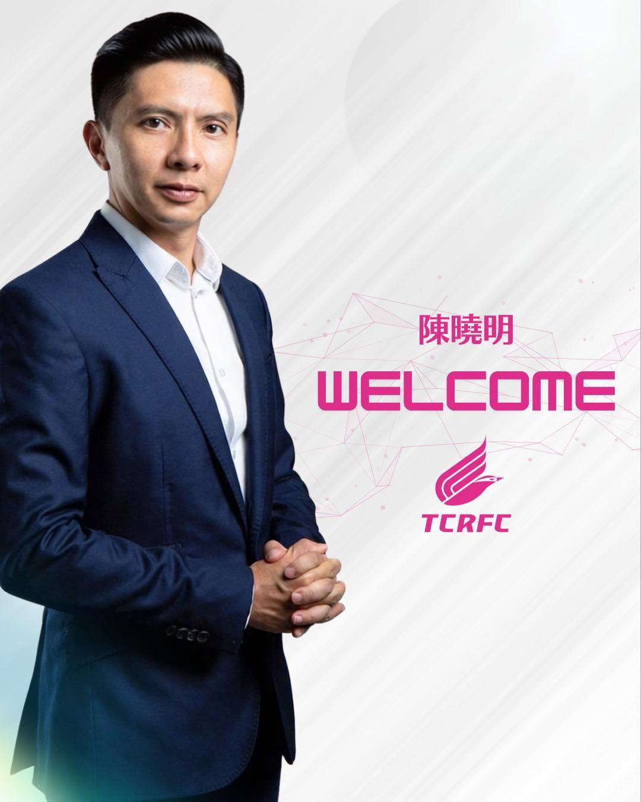




INTERNATIONAL PARTNERSHIPS
國際合作夥伴：連結台灣與世界
Bridging Taiwan with the world through technical consultancy, exchanges, and trial pathways. TCRFC connects local talent to global football networks.
Technical Consultancy
Global Exchanges
專業技術顧問
國際交流
Trial Pathways
Scouting Visibility
試訓通道
球探曝光
KEY PROOF | 關鍵實證
Technical Consultant Hiu‑Ming Chan (AFC Pro) appointed to guide the long‑term development blueprint.
聘請擁有 AFC Pro 證照的陳曉明擔任技術顧問，協助建立長期發展藍圖。
13

Slide 14


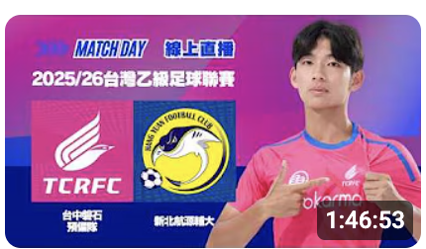



ACADEMY VISION 2026+
2026 足球學院藍圖：打造未來的足球機構
2026
2024-25
2027
2028+
FOUNDATION
OFFICIAL LAUNCH
INTEGRATION
INSTITUTION
Curriculum dev & Pilot programs
Academy Registration & First Intake
Multi-age squads & Education support
Partner facilities & Full campus model
課程開發與試辦
正式學院註冊與首屆招生
多年齡梯隊與教育整合
夥伴場地與完整校區
DIGITAL MOMENTUM
KEY PERFORMANCE INDICATORS 關鍵成功指標
Content Ecosystem
Graduates Per Year
International Trials
Building a digital library of training, matches, and culture to support academy recruitment.
年度畢業生數量
國際試訓機會
Character Benchmarks
建立訓練、比賽與文化的數位資料庫，支援未來學院招生。
品格評估基準
14

Slide 15
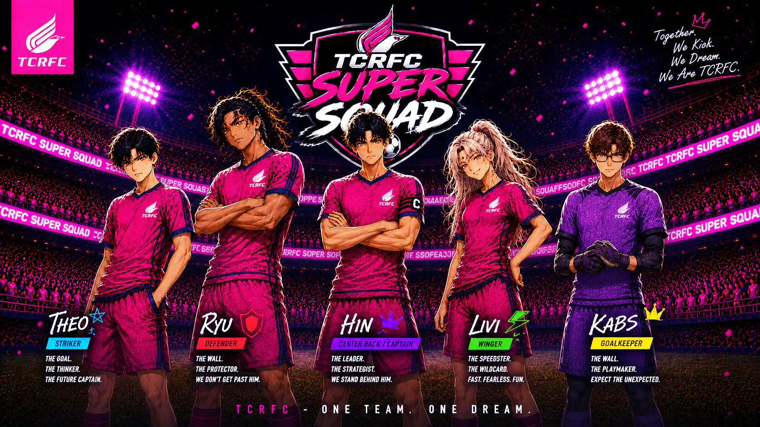
BUILDING FOOTBALL CULTURE.
Beyond the pitch
TCRFC is creating more ways for young players, families, supporters and partners to belong to the brand.
MANGA / COMIC IP
ACADEMY MERCH
A manga-style character-based
comic series created to promote
the Academy, with potential to
develop as an independent
content property.
Youth-focused merchandise that
creates belonging among
Academy players and families.
CLUB MERCH
FAN CLUB
TCRFC merchandise designed to
strengthen club identity, visibility
and supporter pride.
A planned TCRFC Fan Club
to turn spectators into an active
community around the club.
14

Slide 16



THE TCRFC ECOSYSTEM
TCRFC 生態系
TCRFC collaborates with brands, institutions, educators, and sports professionals who share a commitment to youth, excellence, and growth.
TCRFC 與認同青少年發展、專業精神與長期價值的品牌與機構合作。
CORE PARTICIPANTS
STRATEGIC PARTNERS
VALUE & CULTURE
核心參與者
策略夥伴
價值流與文化
Players, Families, Coaches.
Schools, Brands, Health/Fitness, Media.
Development → Competition → Content → Community Impact.
球員、家庭、教練。
學校、品牌、體能健康、媒體。
培育 → 競技 → 內容 → 社會影響。
15

Slide 17







OUR PARTNERS
現有合作夥伴
Collaborating with brands and institutions that share our commitment to excellence. 與認同卓越與成長價值的品牌合作。
STRATEGIC & BRANDING
KIT & APPAREL
LIFESTYLE & COMMUNITY
PERFORMANCE & TRAINING
Additional partners in discussion. Tailored integrations available. 更多夥伴洽談中，可量身訂製合作。
16

Slide 18



WHY BRANDS PARTNER WITH TCRFC
為何選擇TCRFC
SHARED VALUES
PROOF: BRAND ACTIVATION
價值一致．共同成長
• Youth development (青少年培育)
• Discipline & excellence (紀律與卓越)
• Community impact (社會影響力)
• Long-term credibility (長期品牌信任)
BRAND OUTCOMES
品牌成果
• Authentic stories (真實故事)
• Fan engagement (粉絲互動)
FAN CULTURE & MERCHANDISE
• Measurable impact (可衡量影響)
Creating a visible, vibrant identity in the stadium and community.
打造鮮明且充滿活力的球場與社區識別。
TCRFC
17

Slide 19



SPONSORSHIP LOGIC
Flexible. Scalable. Meaningful.
彈性｜可擴展｜有意義
贊助設計邏輯
VISIBILITY
ENGAGEMENT
IMPACT
CO-BUILDING
品牌曝光
互動參與
社會影響
長期共建
• Kit Sponsorship
• Training Wear
• Pitch-side Boards
• Match Day Branding
球衣/訓練服、場邊看板、比賽日品牌露出
• Digital Content Series
• Fan Activations
• Player Appearances
• Social Campaigns
數位內容企劃、粉絲活動、球員出席、社群行銷
• Community Programs
• Youth Scholarships
• School Clinics
• CSR Alignment
社區計畫、青訓獎學金、校園巡迴、企業社會責任
• Academy Naming Rights
• Facility Partnerships
• International Tours
• Strategic Development
學院冠名、場地合作、國際巡迴、策略發展
Partnership models are designed to evolve — from visibility to deeper long-term collaboration.
合作模式可隨關係深化，從品牌曝光走向長期共建。
18

Slide 20
SPONSORSHIP OPPORTUNITIES
25
MORE WAYS TO BECOME PART OF THE JOURNEY.
As the TCRFC ecosystem grows, sponsorship can extend beyond match-day visibility into player development, content and community.
CLUB & MATCHDAY
ACADEMY & YOUTH
INTERNATIONAL
Kit • training wear • pitch-side • match-day
branding • player appearances
Academy support • scholarships • camps • youth
programs • naming opportunities
Overseas training • tours • exchanges • trials
• international player pathways
CONTENT & IP
MERCHANDISE
FAN & COMMUNITY
Manga/comic integration • digital storytelling
• branded content • social campaigns
Club merchandise • Academy merchandise
• co-branded products • limited editions
Fan Club • community activations • school
engagement • supporter experiences
TCRFC | TAICHUNG ROCKS FOOTBALL CLUB

Slide 21

THE OPPORTUNITY
合作機會
BUILDING SOMETHING
THAT LASTS
共建
長遠價值
Partnering with TCRFC is an opportunity to support talent, strengthen community, and shape the future of football in Taiwan.
與 TCRFC 合作，是投資人才、回饋社會、參與台灣足球未來的機會。
Invest in a future‑proof institution.
Proof today. Bigger future.
Partner with us now.
投資一個可長可久的機構。
今日有證據，未來更可期。
現在加入我們。
19

Slide 22
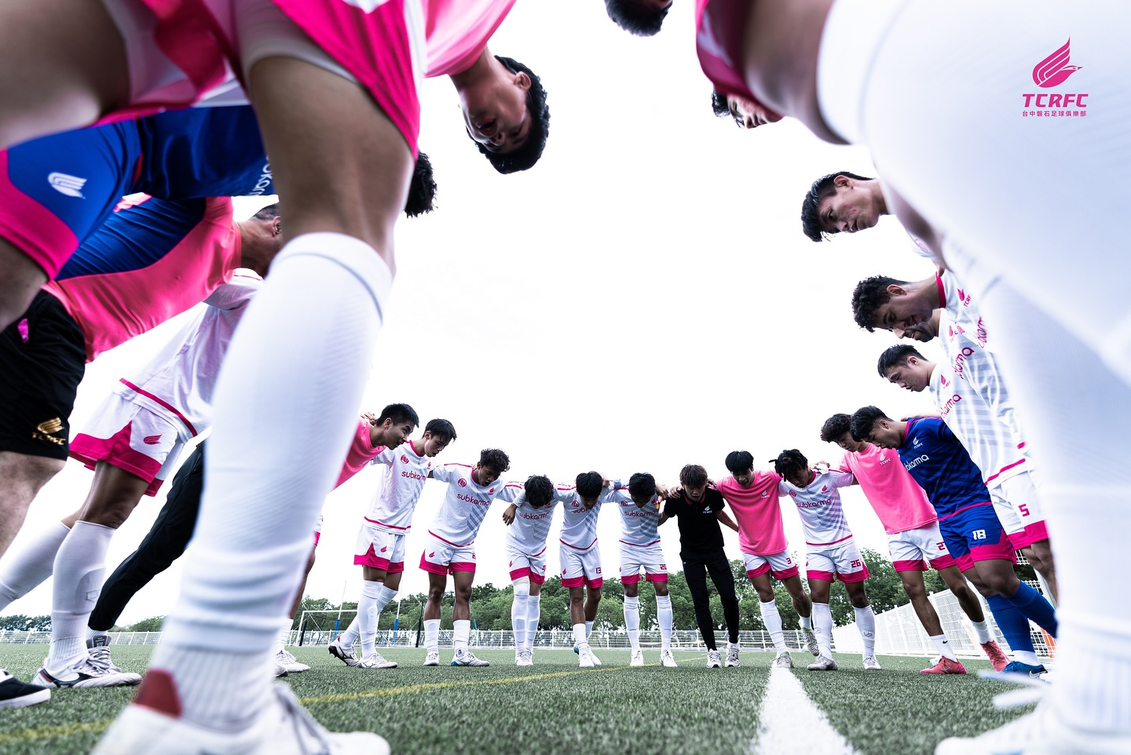






LET'S BUILD THE FUTURE TOGETHER
攜手打造未來
We welcome conversations, visits, and collaborations with partners who believe in long-term impact.
我們誠摯邀請理念相同的夥伴，一同對話、交流與合作。
STRATEGIC MEETINGS
SITE VISITS
CO-DESIGNED PILOTS
策略會談
場域參訪
共創試辦專案
info@tcrfc.tw tcrfc.tw @tcr_fc_2024
20

